Slide 1
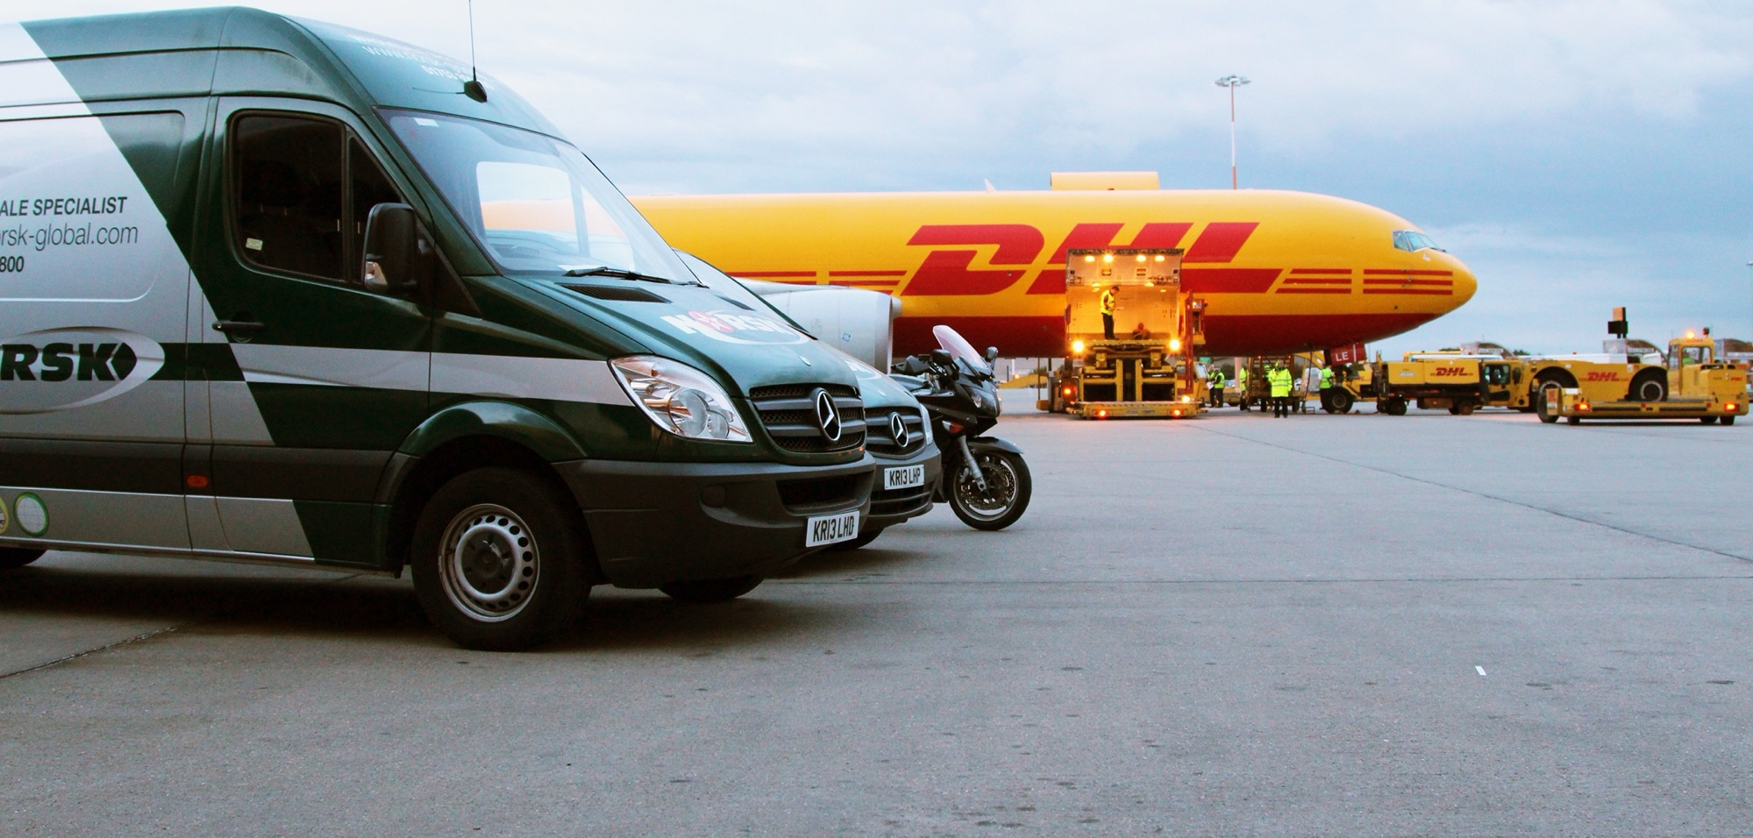

WELCOME

Slide 2
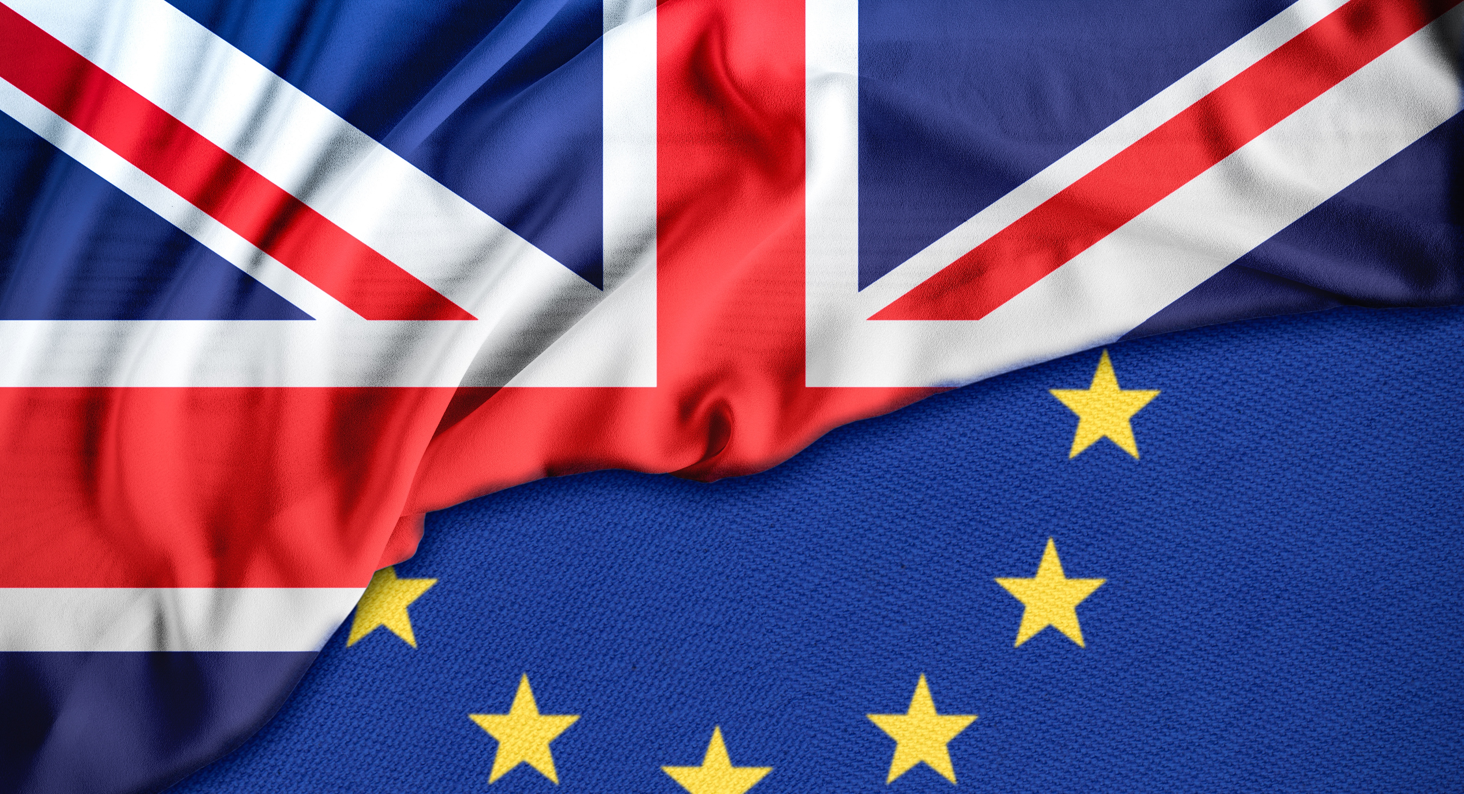
Trade Corporation Agreement (TCA)
“This Agreement establishes the basis for a broad relationship between the Parties within an area of prosperity and good neighborliness characterised by close and peaceful relations based on cooperation, respectful of the Parties’ autonomy and sovereignty”

Slide 3
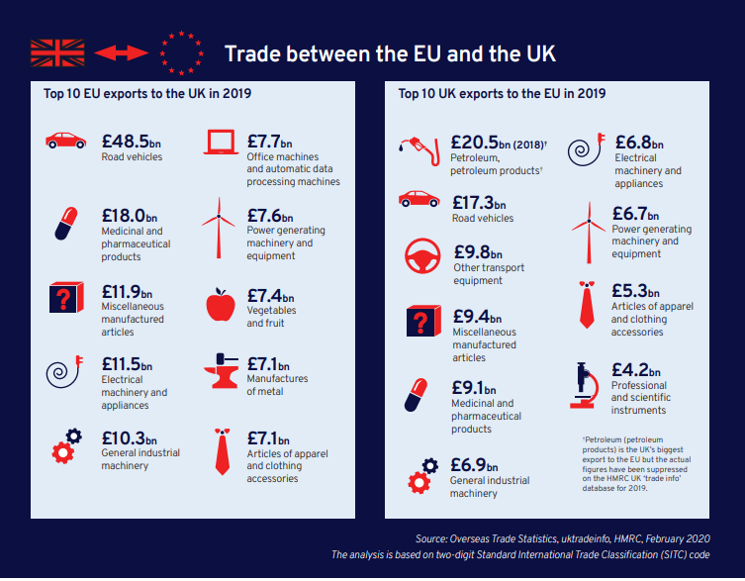
Trade between the EU and UK 2019

Slide 4

TCA: Drawback
UK goods no longer benefit from free movement of goods, leading to more red tape for businesses and adjustments in EU-UK supply chains
Customs formalities and checks on UK goods entering the EU, with more border delays
VAT and, where applicable, excise duties (eg. on alcoholic beverages, tobacco products, etc.) due upon importation (including for online purchases)
UK producers wishing to cater to both EU and UK markets must meet both sets of standards and regulations and fulfil all applicable compliance checks by EU bodies (no equivalence of conformity assessment)
UK food exports must have valid health certificates, and (phyto-)sanitary border checks will be carried out systematically

Slide 5




TCA: Benefits
Zero tariffs and quotas where goods meet the relevant rules of the origin
Mutual recognition of trusted traders programmes (‘Authorised Economic Operators’) ensures lighter customs formalities and smoother flow of goods
Common definition of international standards and possibility to self-declare conformity of low-risk products make it easier for producers to cater to both markets
Specific facilitation arrangements for wine, organics, automotive, pharmaceuticals and chemicals

Slide 6
Rules of Origin
Originating Products
Goods have been wholly obtained in UK or EU (goods grown or harvested, live animals born & raised, products from live animals raised there, products from slaughtered animals born and raised there, fish caught in territorial waters)
Goods substantially transformed inline with relevant
Product-Specific Rule:
Value added/percentage
change of tariff classification
Specific Process
For example, if a UK-manufactured engine contains 30% non-originating content but meets its rule of origin, if that engine is used in the production of a car in the UK or EU, 100% of the value of that engine can be counted towards the originating content of the car.

Slide 7
Rules for Small Consignments of Goods into EU
Proof of Origin Waiver
Small packages: Value under EUR500 | Traveler’s personal luggage: Value under EUR1200 | Commercial imports: Not applicable
Source: https://www.gov.uk/government/publications/rules-of-origin-for-goods-moving-between-the-uk-and-eu-from-1-january-2021

Slide 8
Rules for Small Consignments of Goods into UK
+ | -
Waiver applies to any goods valued under £1000 | Waivers do not apply if it is established that the import forms a series of importations that are being made separately to avoid the rules of origin requirements.

Slide 9
Statement of Origin
Exporter’s Statement of origin provided on a commercial invoice or other commercial document that describes the goods
“Importer’s Knowledge” needs to Obtain sufficient evidence that the goods qualify as originating. This may involve the exporter providing a range of supporting documentation

